Slide 1
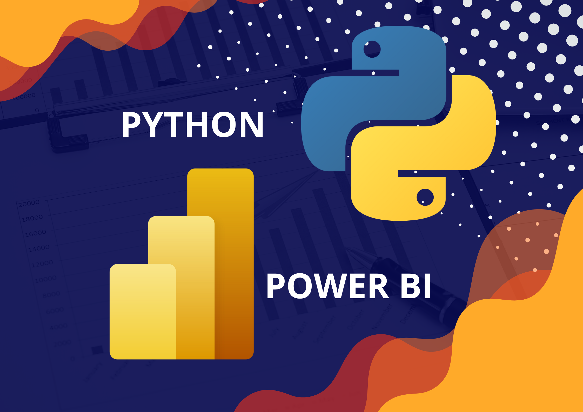
Power BI & Python

Slide 2
Why Use Python in Power BI?
Using Python with Power BI introduces a whole new set of possibilities for working with data. Python turns Power BI into a platform that can do almost anything.

Slide 3
Why Use Python in Power BI?
Data cleaning - you can write Python scripts that automate some of the more repetitive data cleaning tasks that you commonly perform such as removing missing values or correcting date formats.
Data transformation - Python scripts are helpful for datasets that require more extensive data transformations, which may be slow or cumbersome to do in the Power Query Editor, before they can be imported.
Machine learning - enriching your data with predictive analytics (such as regression or natural language processing), or unsupervised machine learning tasks like cluster analysis.
Handling of missing data - Python gives you more options for how you want to handle missing data, such as using machine learning models.
Advanced visualizations - there is no restriction to the type of visualization you can add to your report when using Python. Add highly complex or customized visualizations without needing to download custom visuals in Power BI.
Connectivity - Python gives you the ability to connect to almost any data source even if Power BI does not support it as one of its own built-in connections.

Slide 4
Limitations
Data sources added with Python must be set to public.
Only Pandas DataFrames can be imported into Power BI using Python.
Scripts that take longer than 30 minutes to run will time out, as will Python visuals that take more than 5 minutes to run.
There are a limited number of Python libraries supported by Power BI Service.
Reports using Python can only be refreshed in Power BI Service through a personal gateway (the enterprise or standard gateway is not supported).
Python visuals do not support cross-filtering. This means that selecting an element in a Python visual will not cause other visuals to filter by that selection, thus removing some degree of interactivity in the Power BI report.

Slide 5
Setup

Slide 6
Setup
Install Power BI from Windows store, here.
Install the latest Python interpreter, here.
During the installation process, add Python to the PATH
Run the following commands on a CMD terminal:
pip install numpy pandas matplotlib scikit-learn

Slide 7
Python Introduction

Slide 8
Python 101
Python is a general-purpose programming language that is becoming ever more popular for data science.
It is a verbose language that is easy to read
Uses indentation to define the scope of a function
One of the largest collection of libraries available
Resources:
W3Schools
Python 101

Slide 9

NumPy
Also known as Numerical Python, designed to offer the same functionally as Matlab into a python environment
A low-level library that allows users to access several matrices based operations
Can speedup the code execution considerably

Slide 10

Pandas
Is a fast, powerful, flexible and easy to use open-source data analysis and manipulation tool, built on top of the Python programming language.
A Pandas DataFrame is a 2-dimensional data structure, like a 2-dimensional array, or a table with rows and columns.
The data structure is understood by Power Bi
It is the standard library to use on loading and cleaning data

Slide 11

Matploblib
Is a comprehensive library for creating static, animated, and interactive visualizations in Python.
Offers the same functionality as gnuplot into a Python environment
Allows to draw any type of visualization
Some libraries are built on-top of it to ease the development of specific plots:
Seaborn
Plotly

Slide 12

Scikit-learn
Simple and efficient tools for predictive data analysis
Built on NumPy, SciPy, and matplotlib
Offers a wide range of learning models

Slide 13
Connectivity

